Slide 1
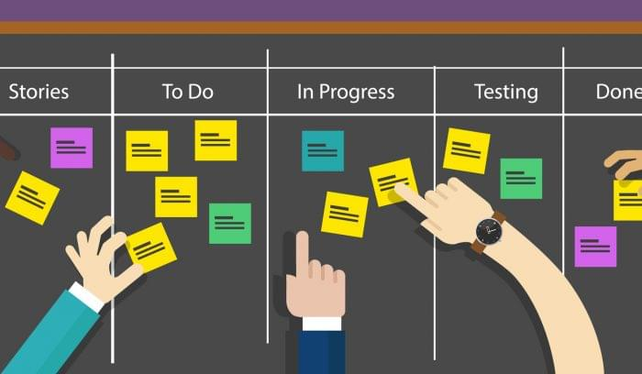
Formation Kanban

Slide 2
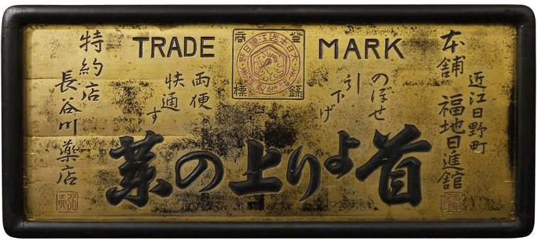
看板 (カンバン )

Slide 4
1940

Slide 5
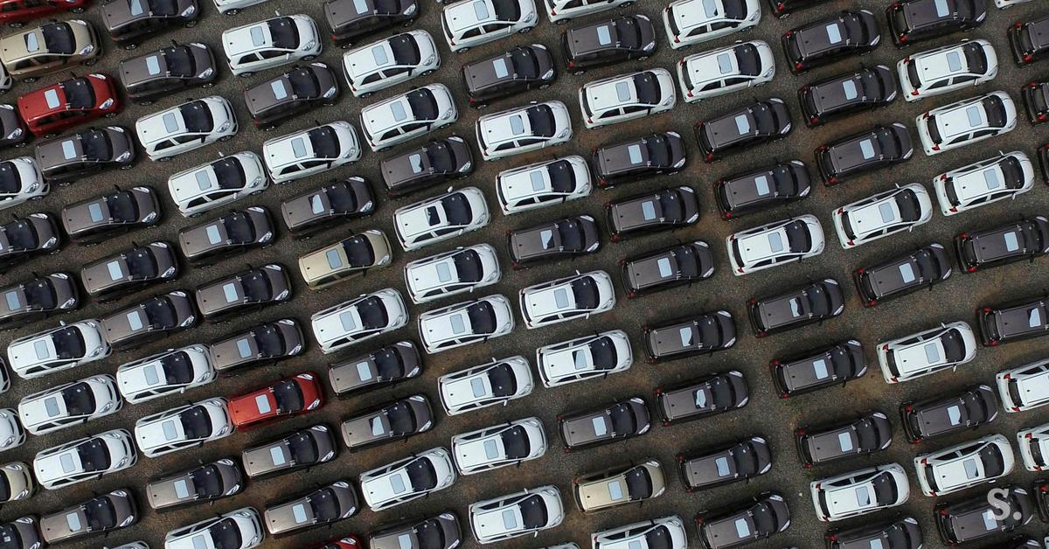

Slide 6
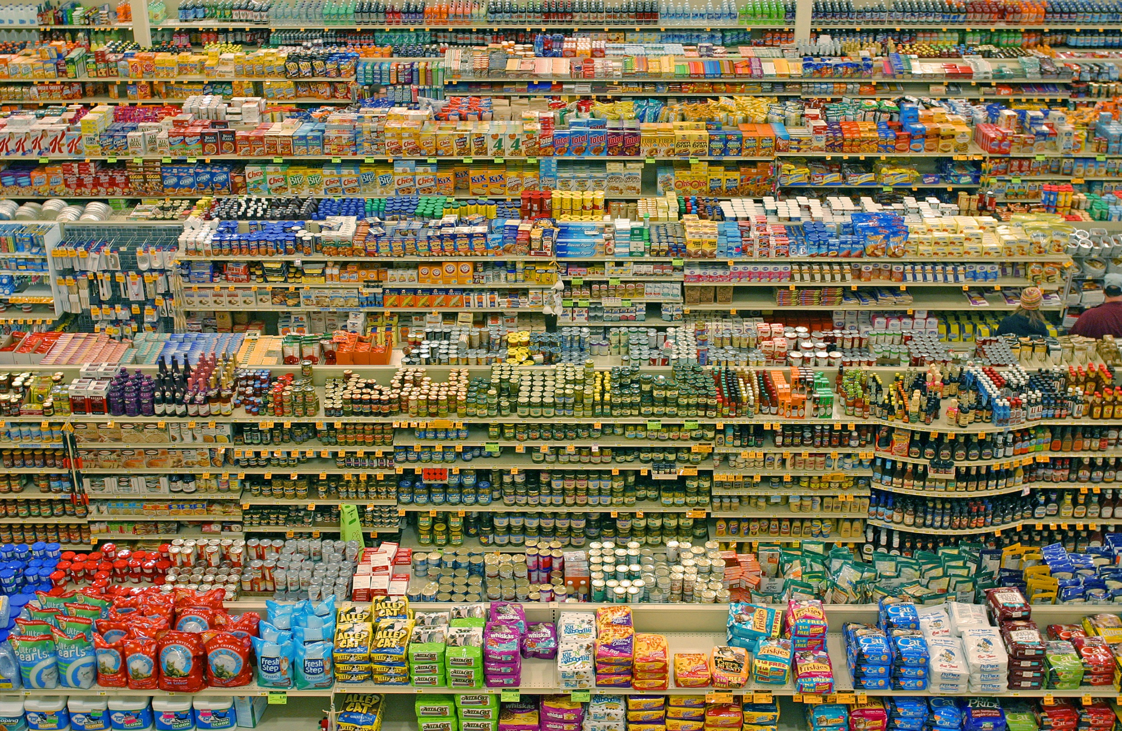
Supermarché

Slide 7
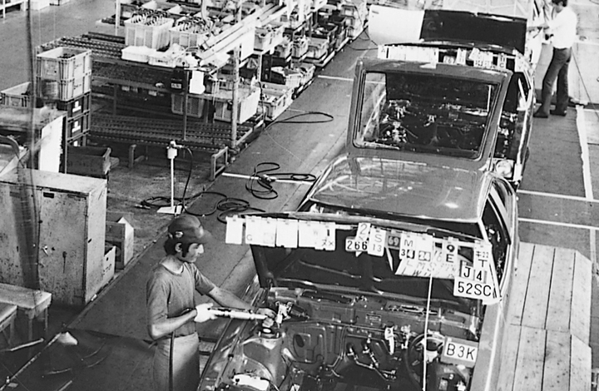
1953

Slide 8
Quatre principes de Kanban
Commencez par ce que vous faites actuellement
Acceptez d’appliquer des changements progressifs
Respectez le processus actuel, les rôles, les responsabilités et les titres
Leadership à tous les niveaux

Slide 9
Les 6 règles d’application de Kanban Toyota
Each process issues requests (kanban) to its suppliers when it consumes its supplies.
Each process produces according to the quantity and sequence of incoming requests.
No items are made or transported without a request.
The request associated with an item is always attached to it.
Processes must not send out defective items, to ensure that finished products will be defect-free.
Limiting the number of pending requests makes the process more sensitive and reveals inefficiencies.

Slide 10
Ce qu’on a appris aujourd’hui

